Slide 1
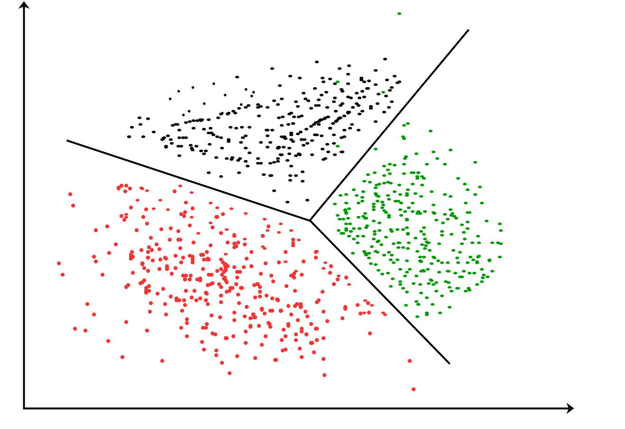
Global Clustering Development
Groupe NO.1
1. Vishweshwar Parmeshwar Khasge.
2. Aniket Pralhad Patil.
3. Vijaykumar Dattatray Patil.
4. Akshata Laxman Patil.
5. Prathamesh Narayan Suryawanshi
6. Karadi Snehitha.

Slide 2
Exploratory Data Analysis ( EDA )
Checked for missing values.
Visualized Distributions of key variables.
Found Correlation between variables.
Handled missing values with mean/mode imputation.
Normalized numerical variables to ensure uniform scaling.
Removed duplicate entries for consistency.

Slide 3
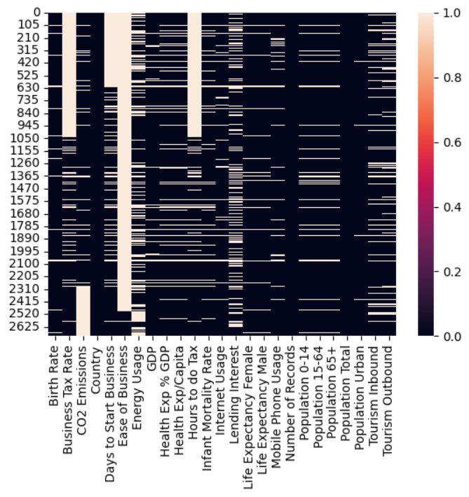
Visualize Missing values
Many features, such as "Birth Rate," "Internet Usage," "Life Expectancy (Male and Female)," and "Mobile Phone Usage," show very few missing values, with mostly dark areas indicating completeness.
"Business Tax Rate" and "Ease of Business" also appear to have a high proportion of missing values.

Slide 4
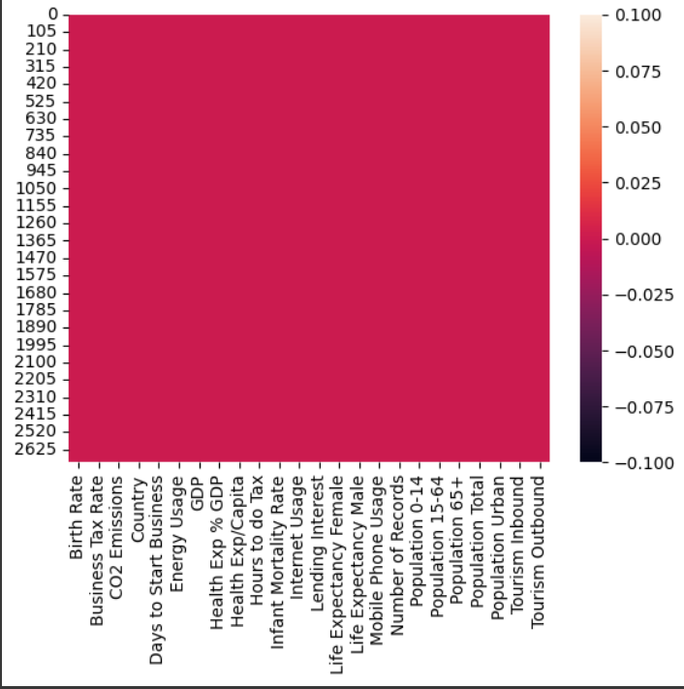
Cleaned Missing Values
The entire heatmap is uniformly shaded, suggesting there are no missing values in any feature.
The dataset has undergone a cleaning process that removed or imputed all missing values, resulting in a fully complete dataset.
Every feature (column) is equally complete, with no gaps or inconsistencies, suggesting that the data is now consistent and ready for analysis.

Slide 5
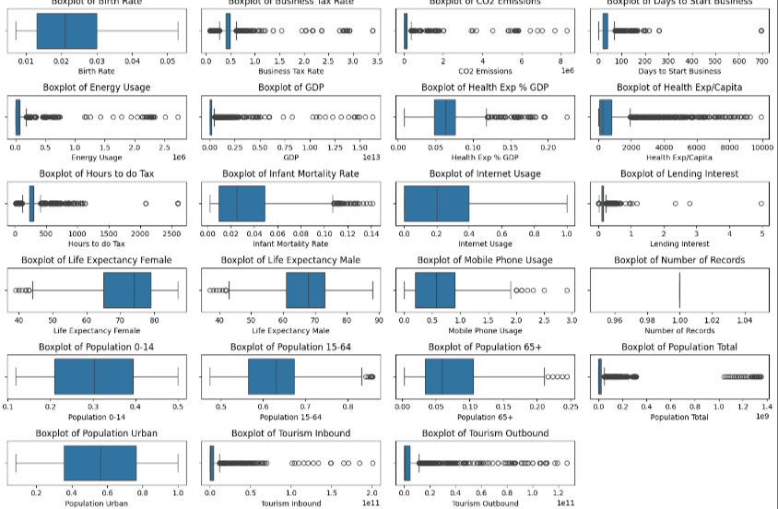
Detected Outliers
Many of the metrics (e.g., GDP, CO2 Emissions, Energy Usage, and Tourism) show a significant presence of outliers on the higher end.
Metrics like Life Expectancy (Male/Female) and Infant Mortality Rate appear to have relatively compact distributions with fewer outliers.
Some boxplots, such as Number of Records, have little variation, possibly indicating categorical or binary data.

Slide 6
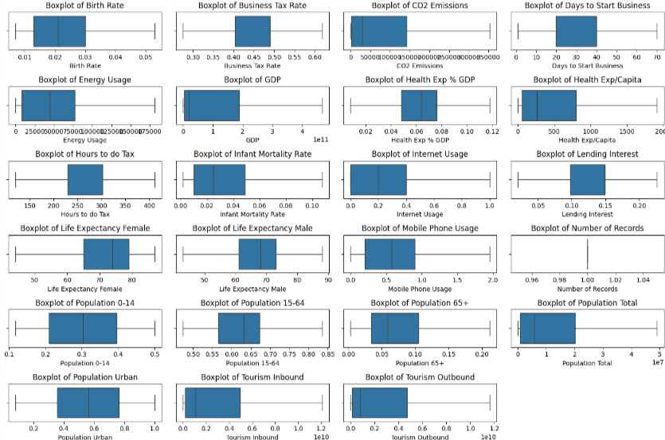
Removed Outliers ( IQR Method)
Health Expenditure per Capita and Days to Start Business now better represent the majority population.
For instance, Life Expectancy (Female/Male) and Mobile Phone Usage appear more symmetric.
Metrics like Internet Usage and Infant Mortality Rate still exhibit wide IQRs, reflecting inherent variability even without outliers.
This cleaned dataset will likely improve the performance of statistical analyses or machine learning models, as extreme values often distort results.

Slide 7
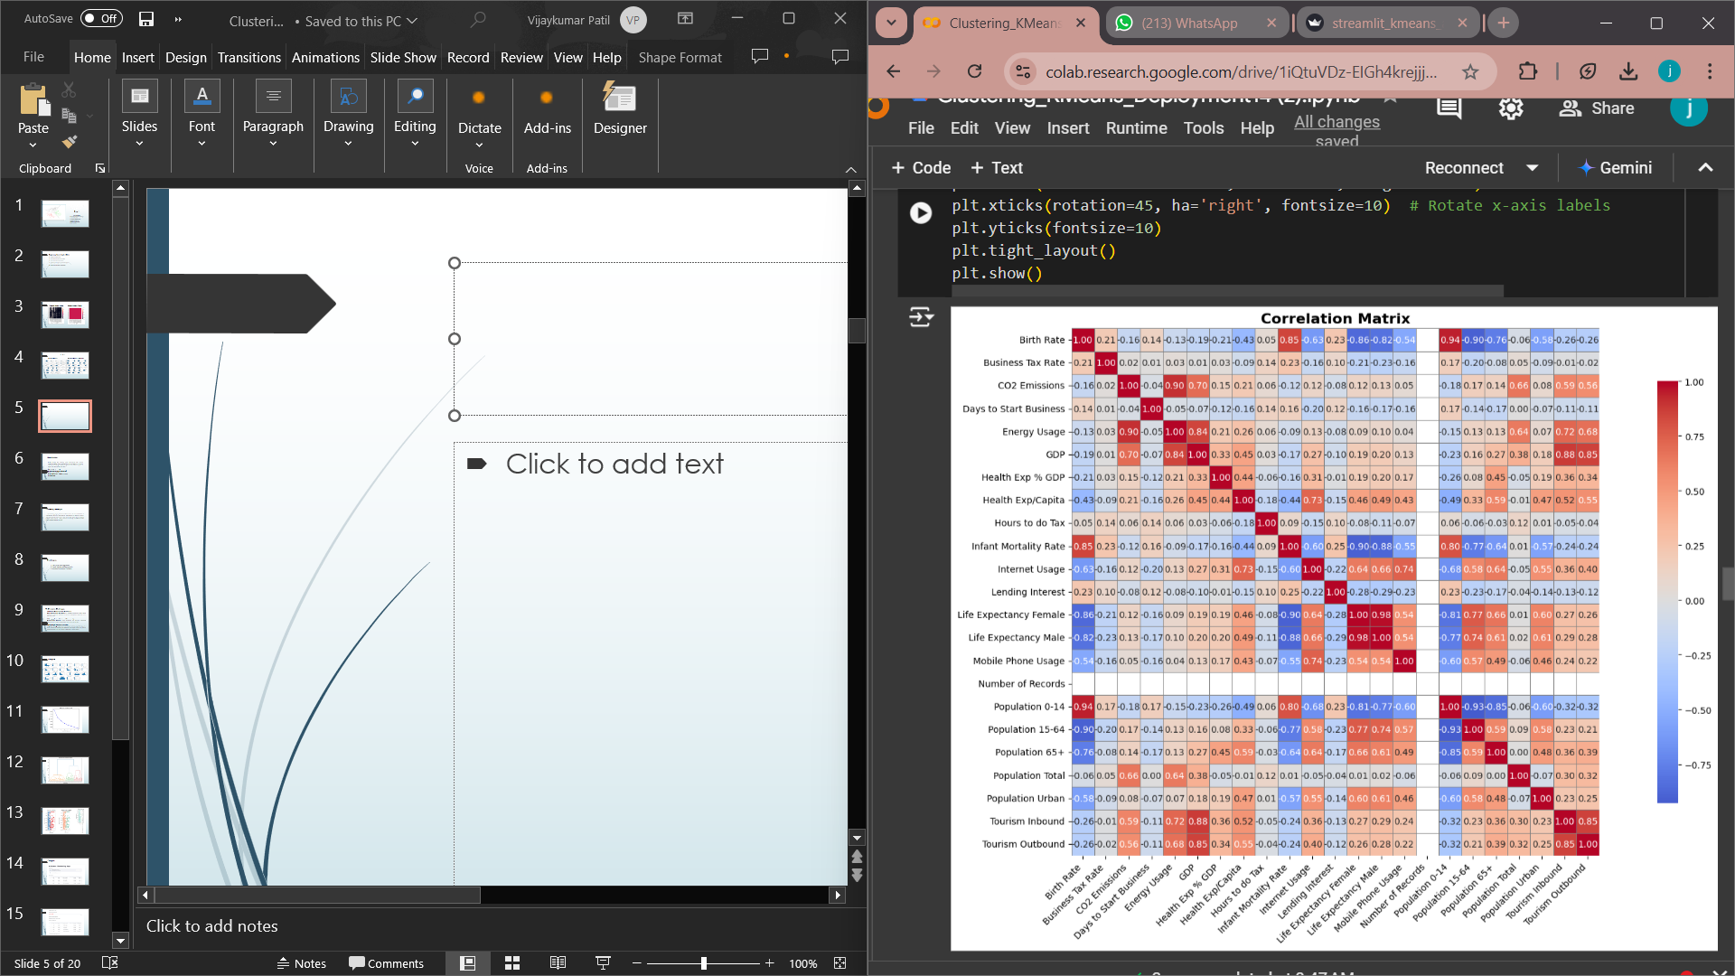
Correlation Matrix
Strong correlation (~0.90) indicates that countries with higher GDP tend to have higher CO2 emissions.
Population Total is highly correlated with Population 0-14, Population 15-64, and Population Urban.
Correlated variables like CO2 Emissions and Energy Usage can be combined for predictive modeling.

Slide 8
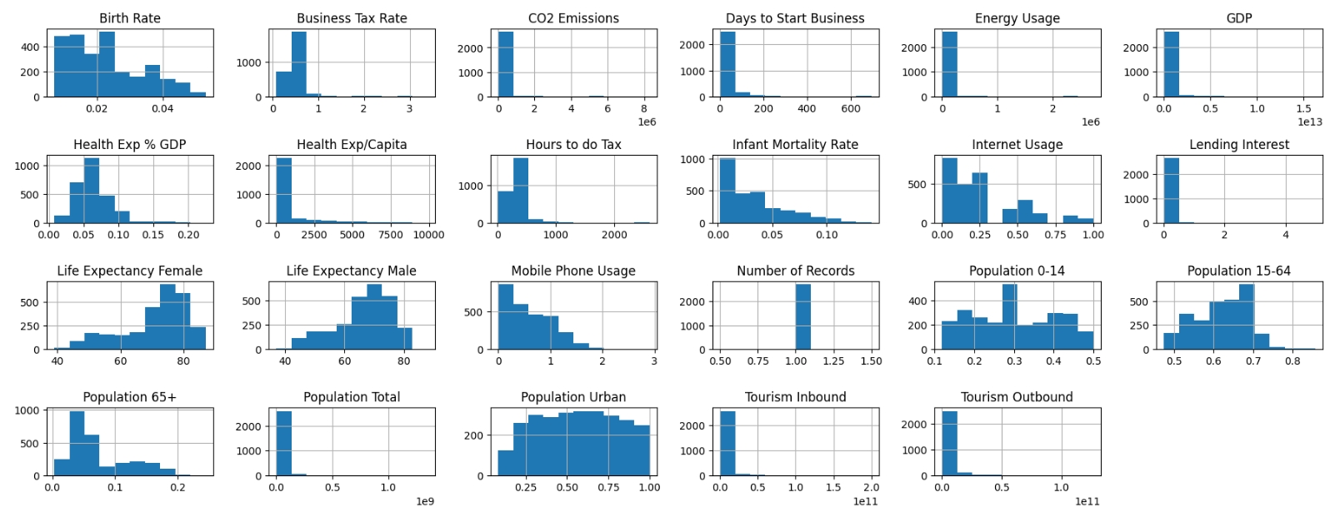
Histogram
The image displays histograms for various economic, demographic, and health-related variables, providing insights into the distribution of each feature.
CO2 Emissions, Days to Start Business, Energy Usage, GDP, Hours to do Tax, Infant Mortality Rate, Lending Interest, Tourism Inbound, and Tourism Outbound all show strong right skew
The presence of multiple peaks in some variables suggests potential clustering or grouping within the data, which might be explored further with clustering methods.

Slide 9
Model Building:
Model building for clustering global development data involves identifying patterns, trends, and similarities across countries or regions to inform policy-making, identify development needs, and track progress on global goals. Here are the main steps:
Data Collection and Preprocessing
2. Feature Selection and Engineering
3. Clustering with K-means
4. Model Evaluation and Interpretation
5. Deployment

Slide 10
Clustering Technique:
In a clustering project, K-means is often chosen as the final model due to its computational efficiency, interpretability, and suitability for datasets with well-separated, spherical clusters. While other models may handle specific scenarios better, K-means provides a strong balance of simplicity and effectiveness for general-purpose clustering projects.

Slide 11
Challenges:
1. Data Quality and Completeness
2. Feature Selection and Dimensionality
3. Algorithm Selection and Evaluation

Slide 12
To Overcome Challenges:
1. Improving Data Quality and Completeness
Data Imputation and Enrichment: Use imputation techniques, such as mean substitution, regression imputation, or machine learning-based imputation, to fill in missing values.
2. Managing Feature Selection and Dimensionality
Dimensionality Reduction: Apply techniques like Principal Component Analysis (PCA) to reduce dimensionality while preserving variance.
3. Selecting and Evaluating Algorithms
Algorithm Testing: Experiment with multiple clustering algorithms (e.g., K-means, hierarchical clustering, and DBSCAN) and compare results using metrics like the silhouette score can also help to qualitatively assess clusters.

Slide 13
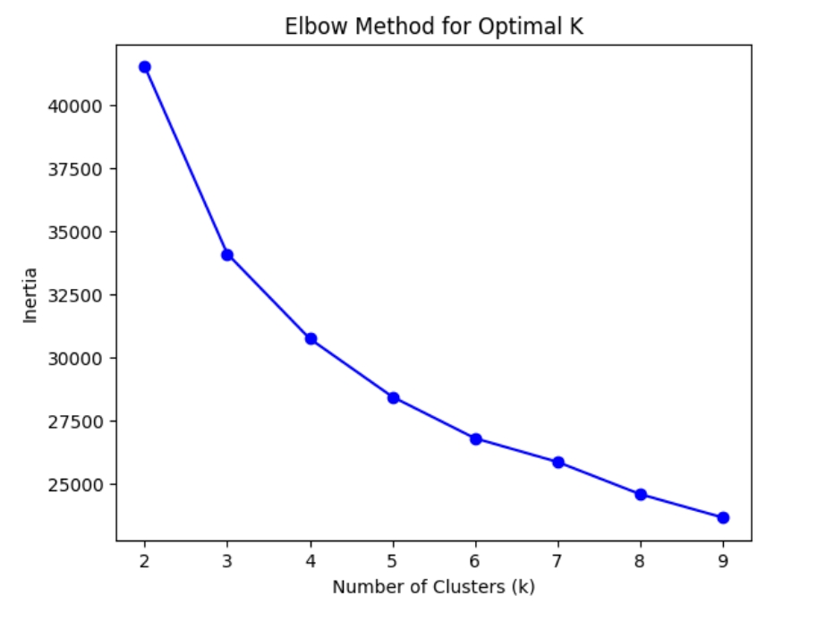
The Elbow Method involves plotting the distortion score (or sum of squared errors) against the number of clusters (K).
The optimal number of clusters (K) is 5.
The optimal K is identified at the "elbow" point, where the rate of decrease in distortion score becomes less steep.

Slide 14
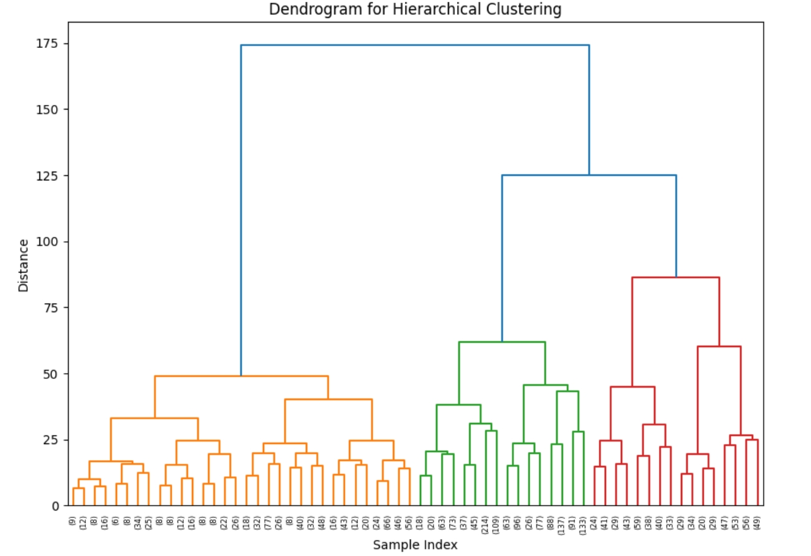
The dendrogram shows a tree-like structure, representing how data points (or clusters) are merged step-by-step.
At the bottom, individual data points (or samples) are represented. As you move up, clusters are formed by merging smaller clusters or data points.
Deciding the number of clusters often involves visualizing where there are large vertical jumps between merges. For example, the large jump after the three main clusters indicates that three might be a natural choice.

Slide 15
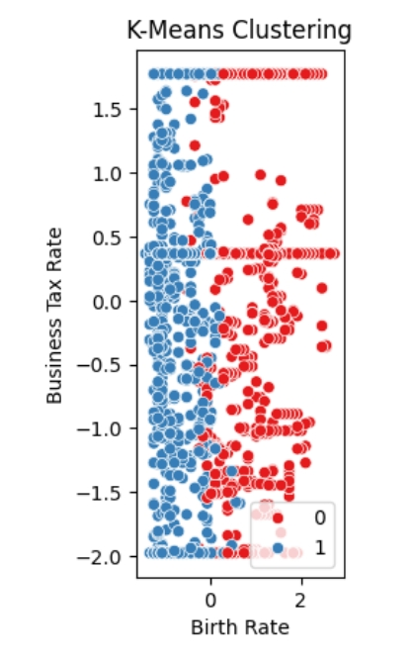
The data points are divided into two clusters, indicated by the two distinct colors (red and blue).
The clusters are separated based on patterns in "Birth Rate" and "Business Tax Rate.“
One cluster (blue) primarily groups points with lower "Birth Rate," while the other cluster (red) focuses on higher "Birth Rate.“
The blue cluster is denser along the left side of the plot, suggesting a concentration of data points with lower "Birth Rate.“
The red cluster has a broader spread across the right side, indicating higher variability in "Birth Rate" values.
The clustering is based on a predefined number of clusters (in this case, 2).

Slide 16
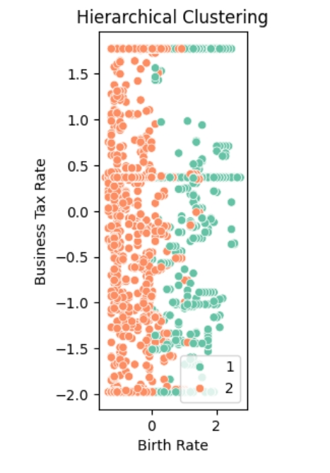
The data points are divided into two distinct clusters, represented by different colors (orange and green).
Each cluster is labeled in the legend as "1" and "2".
The separation of clusters may indicate a natural division in the dataset based on the combination of birth rate and business tax rate.
This clustering could potentially be used to understand different categories of regions or countries based on these two factors.

Slide 17
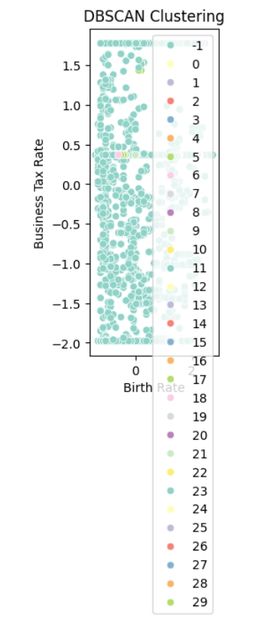
The DBSCAN algorithm identified multiple clusters, each represented by a different color.
A significant number of points are labeled as "-1," which represents noise or outliers according to DBSCAN. These points are not part of any identified cluster.
The presence of many small clusters and noise points implies a highly heterogeneous dataset, with significant variations in density across regions in the plot.
The legend shows multiple clusters (from cluster 0 to cluster 29). This suggests that DBSCAN identified many distinct groups, indicating potentially high variability in the data structure.

Slide 18
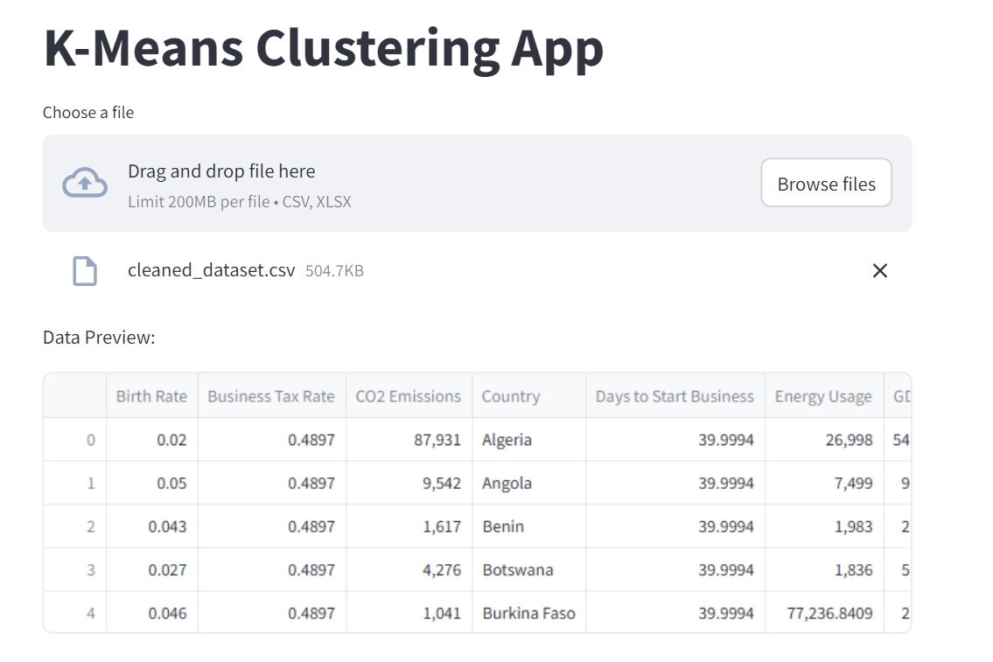
Output:

Slide 19
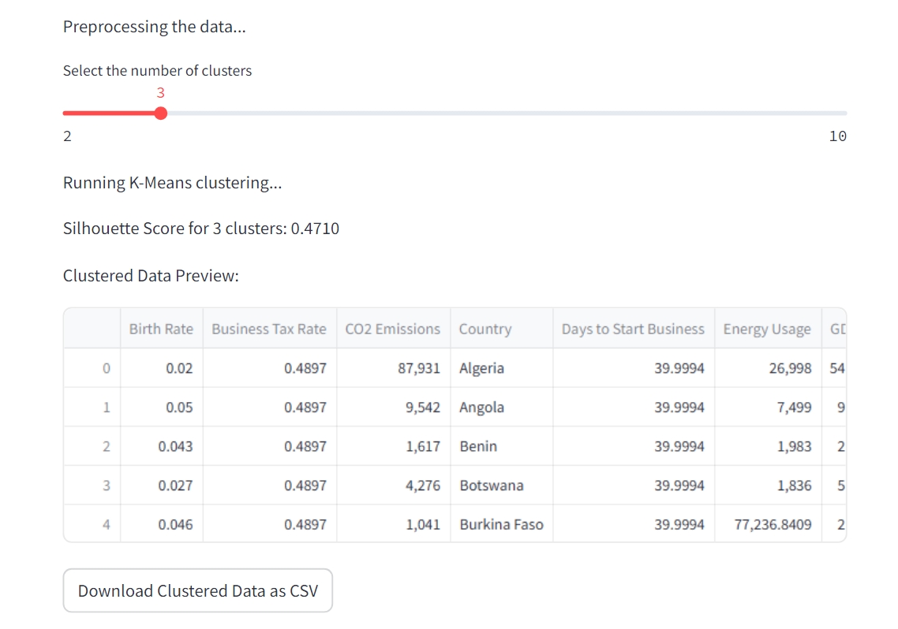

Slide 20
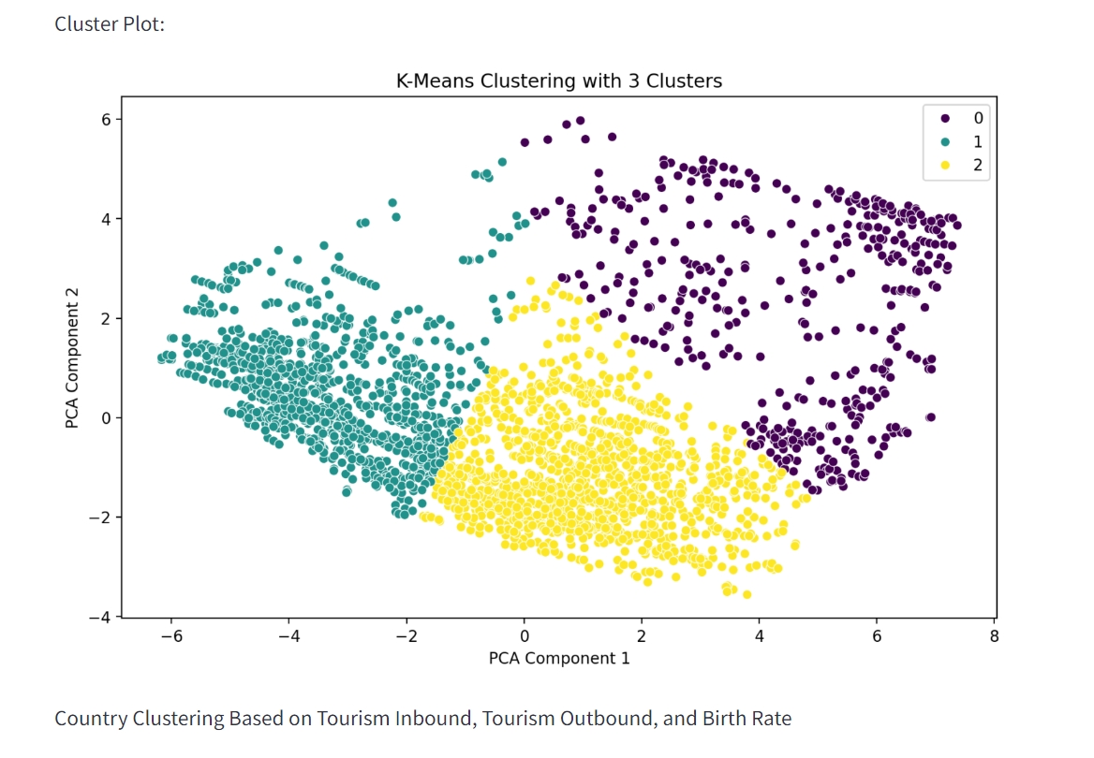

Slide 21
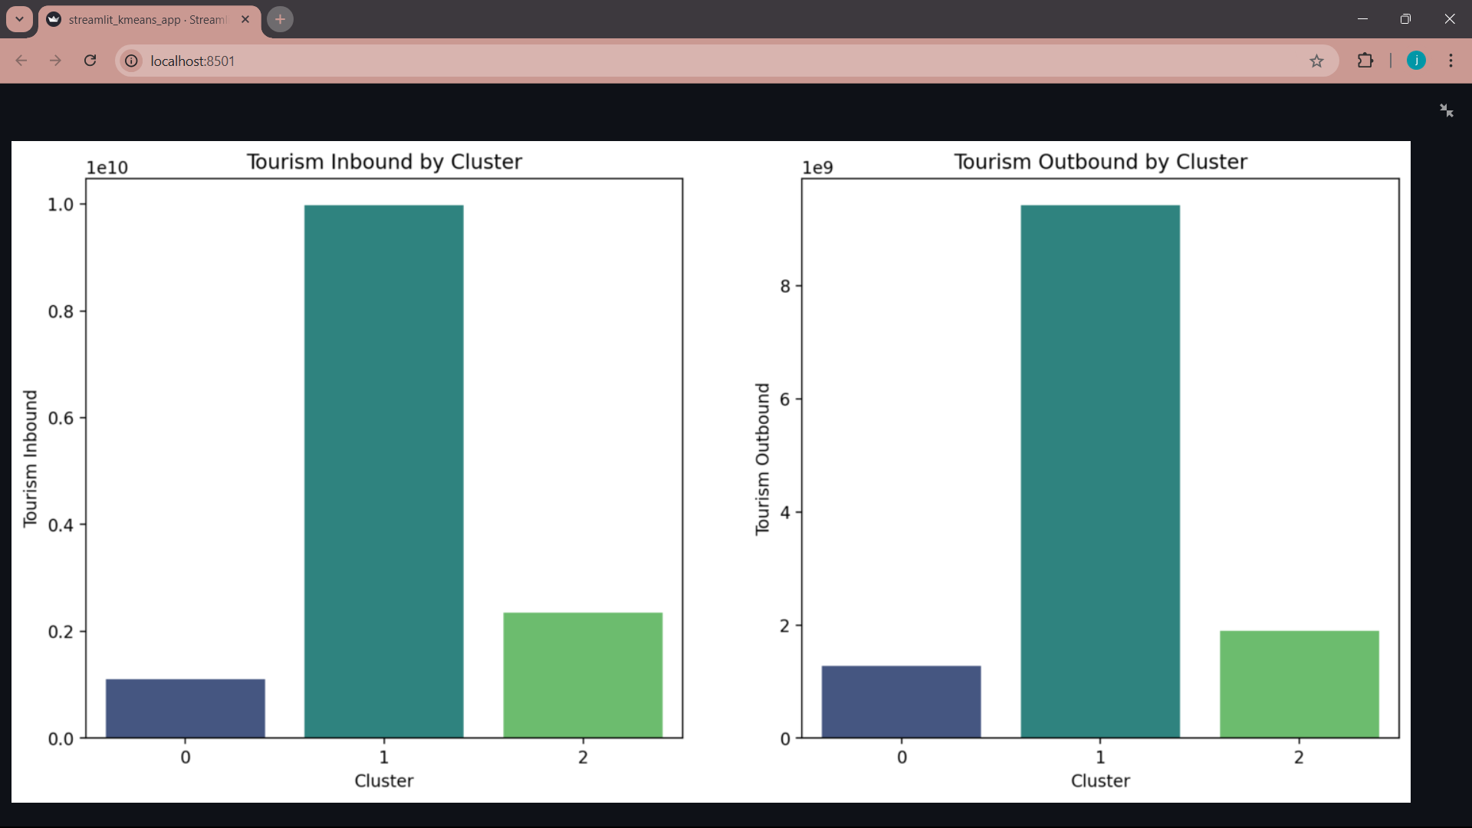

Slide 22
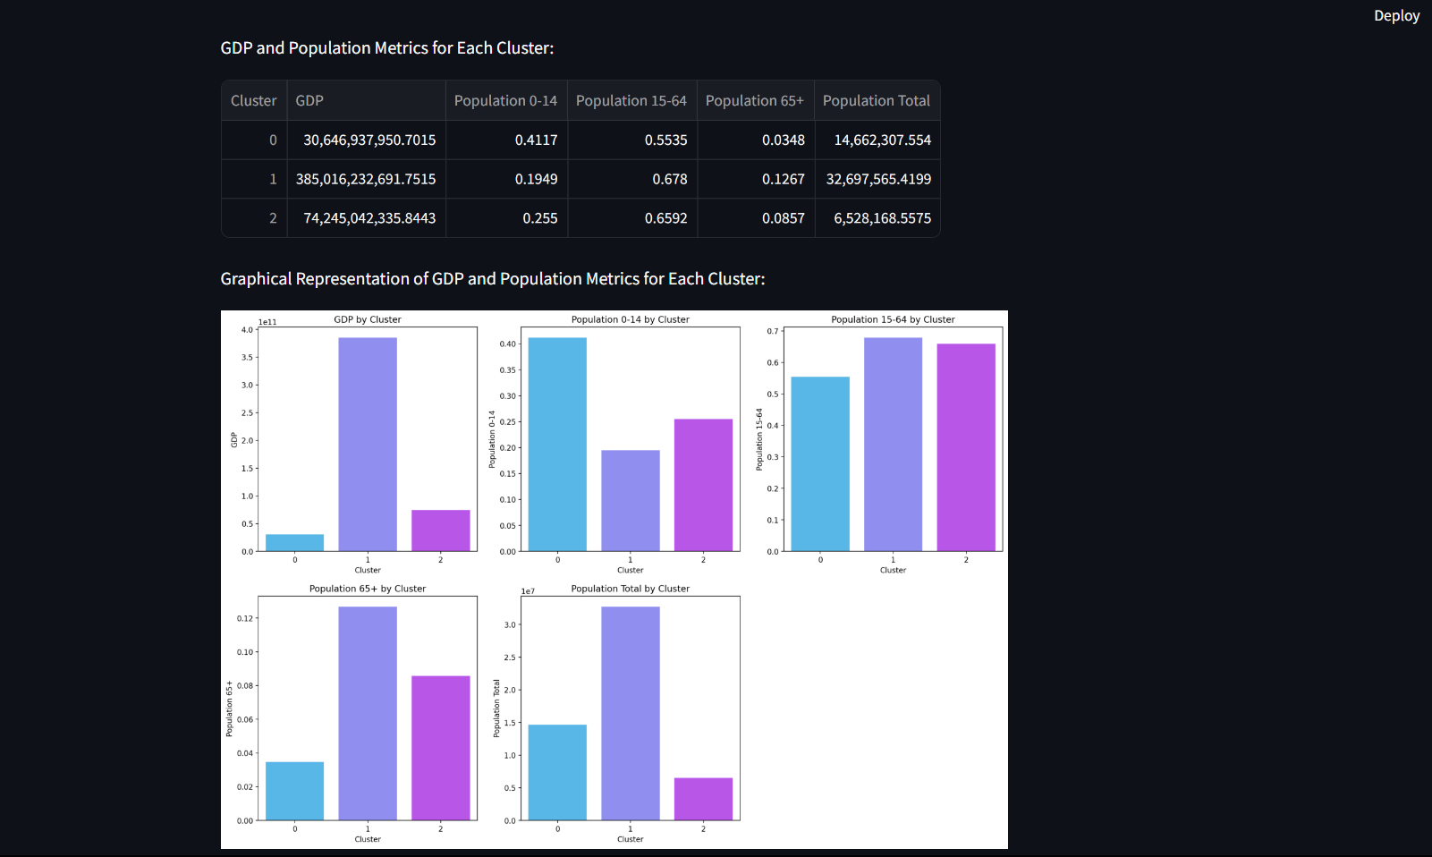

Slide 23
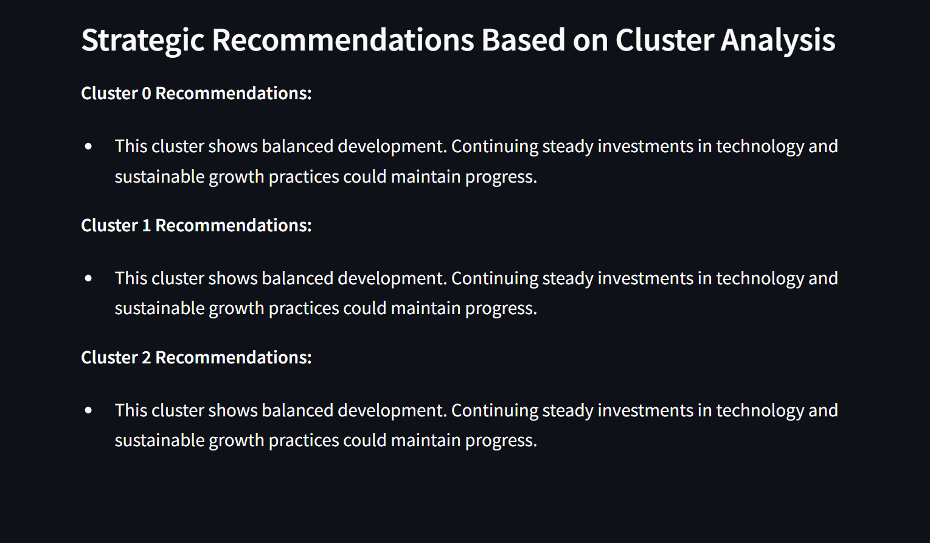

Slide 24
Conclusion:
The global clustering project groups countries based on similarities in factors like birth rates, business environment, CO2 emissions, health spending, and population details. This grouping helps reveal patterns across nations, showing which countries face similar challenges or strengths. The results can guide policymakers by highlighting where improvements could be made, such as making it easier to do business, lowering emissions, or better managing health resources. Overall, the project helps understand the diversity among countries and supports targeted approaches to address each group’s specific needs.

